Slide 1
MACHINE LEARNING PROJECT RELIANCE STOCK PRICE PREDICTION

Slide 2
GROUP - 5

Slide 3
BUSINESS PROBLEM :
Predict the Reliance Industries Stock Price for the next 30 days
OBJECTIVE:
Split the last year into a test set- to build a model to predict stock price
Find short term, & long term trends.
Understand how it is impacted from external factors or any big external events.
Forecast for next 30 days.

Slide 4
PROJECT STATEMENT
This dataset consists of about 1976 stock entries for Reliance.
We collected data from 1-Jan-2015 to 28-Feb-2023.
There are Open, High, Low and Close prices that you need to obtain from the web for each day starting from 2015 to 2022 for Reliance Industries stock.

Slide 5
LIBRARIES USED
Pandas
Numpy
Matplotlib
Seaborn
yFinance
Tenserflow
Plotly
Random Forest Regresser
Sklearn
SVR
Statsmodel
Then, Read the Dataset

Slide 6
1976
TOTAL STOCK ENTRIES

Slide 7
PROJECT SECTION
Exploratory Data Analysis (EDA)

Slide 8
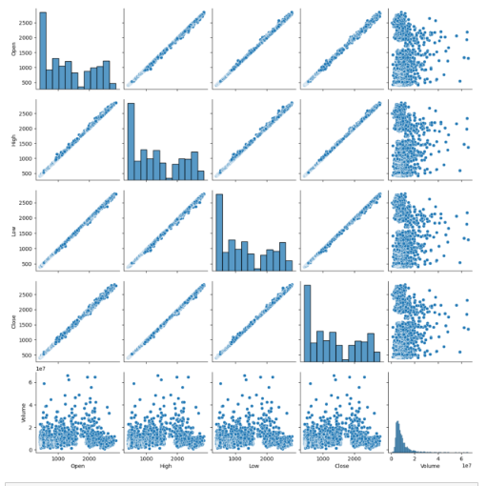
PAIR PLOT
Pair plot to view and visualize trend of Open, High, Low and Close Stocks
The pair plot provides a visual representation of the relationships between the different numerical variables (Open, High, Low, Close) over time.

Slide 9
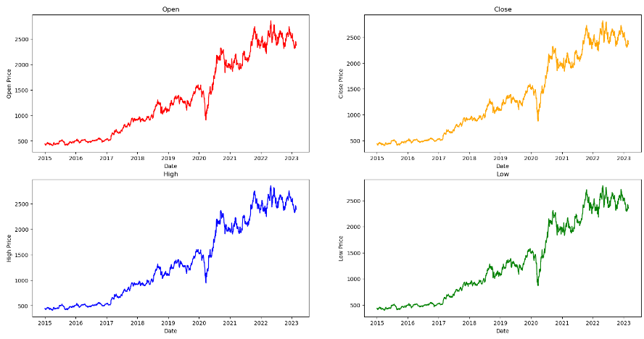
LINE PLOT OF STOCK PRICES
The line plots show the trends of the Open, Close, High, and Low stock prices over time.
These plots visually represent the fluctuation and movement of stock prices across different dates

Slide 10

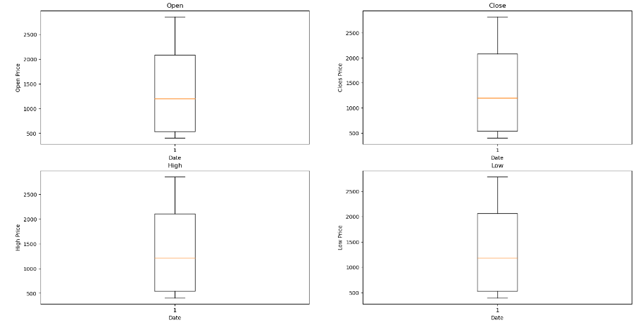
BOX PLOT OF STOCK PRICES
The box plots shows the distribution and central tendency of the Open, Close, High, and Low stock prices
From the box plot it is clear that there are no outliers in the dataset

Slide 11
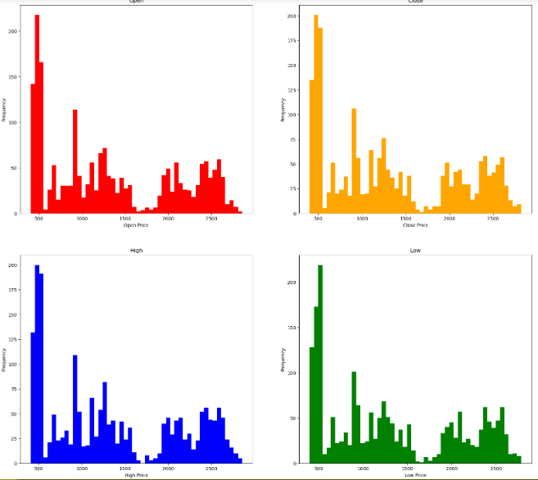
HISTOGRAM OF STOCK PRICES
The histograms display the frequency distribution of the Open, Close, High, and Low stock prices
It visualizes occurrence and spread of different price levels.

Slide 12
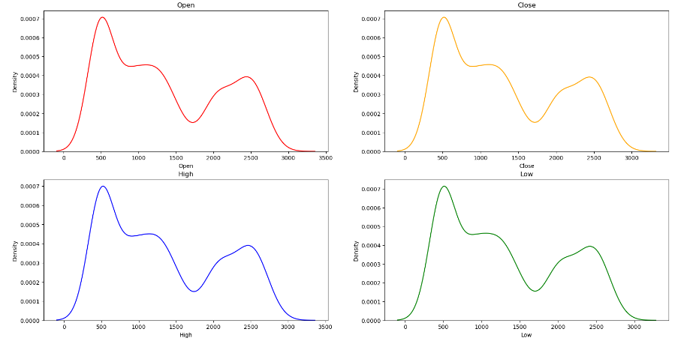
KDE PLOTS
KDE plots provide a smoothed, continuous representation of the distribution of Open, Close, High, and Low stock prices
It is helping us to assist in understanding the underlying probability density function of the data.

Slide 13
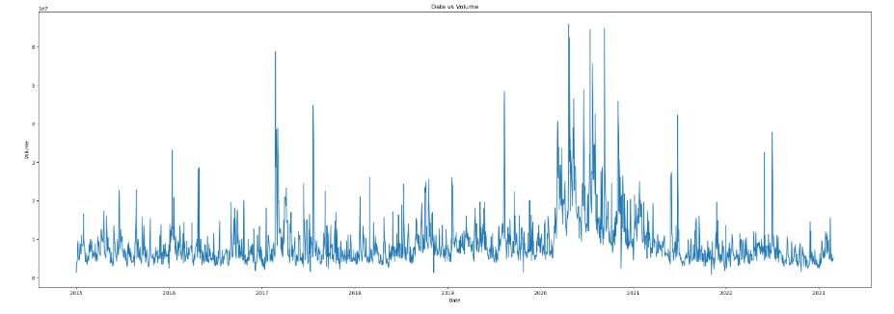
VOLUME vs DATE PLOT
The volume plot represents the trading volume of the stock over time
It helps in understanding the pattern and intensity of trading activities for the given stock

Slide 14
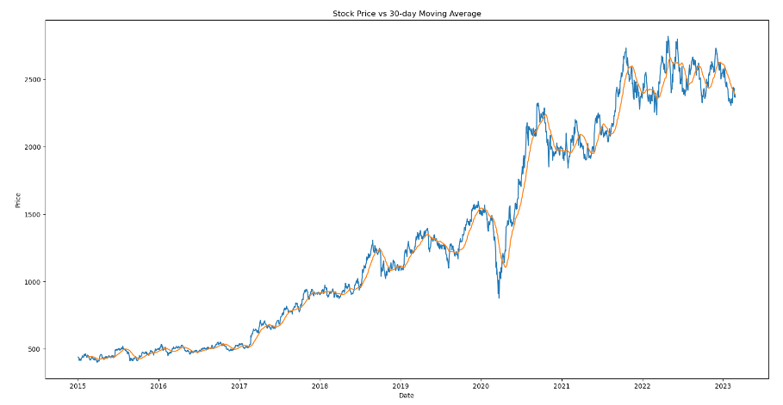
SHORT TERM MOVING AVERAGE PLOT
The 30-day moving average plots illustrate the smoothed trends of the stock prices over specific time periods
Stock had a major short term downtrend during the year 2020

Slide 15
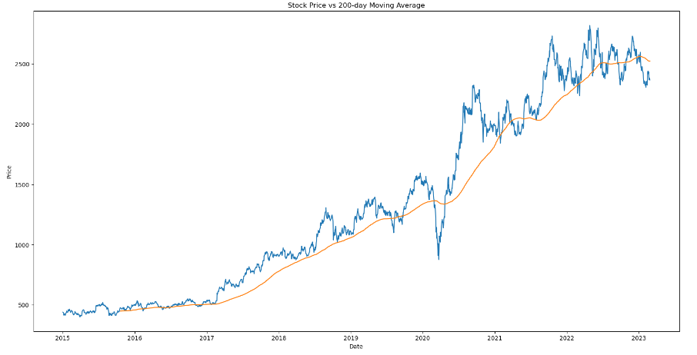
LONG TERM MOVING AVERAGE PLOT
The 200-day moving average plots illustrate the smoothed trends of the stock prices over specific time periods
In long term, Stock price is in upward trend

Slide 16
PROJECT SECTION
Model Building

Slide 17
MODELS USED
We trained our dataset using different algorithms as mentioned below
Random Forest
LSTM
Support Vector Machine
83.94%
GRU
88.67%
KNN
49.26%
87.53%
74.63%

Slide 18
K NEAREST NEIGHBOUR
Accuracy – 74.63%
KNN
74.63%

Slide 19
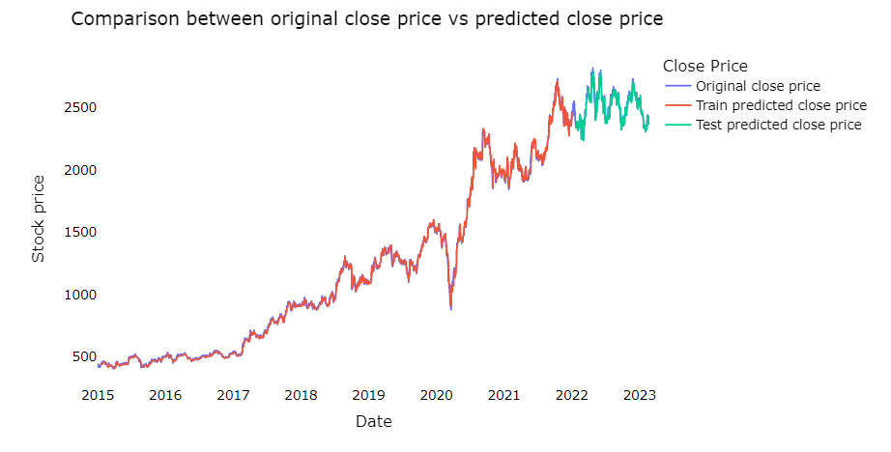
CLOSE AND ORIGINAL PRICE COMPARISON
The graph visualizes the model's predictions for both the training and testing datasets, providing a clear representation of the model's performance across different sets of data
The plotted data enables the analysis of temporal trends in stock prices, offering insights into the historical behavior of the stock and potential patterns over time
The graph shows the preparation of data for visualizing the comparison between original and predicted stock prices

Slide 20
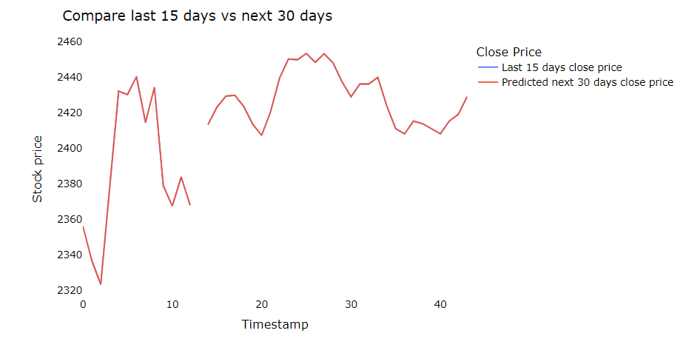
15 AND 30 DAYS CLOSE PRICE COMPARISON
The graph visualizes the comparison between the historical stock prices from the last 15 days and the predicted stock prices for the next 30 days
The predicted 30 days close price shows up and down trend for stock prices however most of the time it is going upward

Slide 21
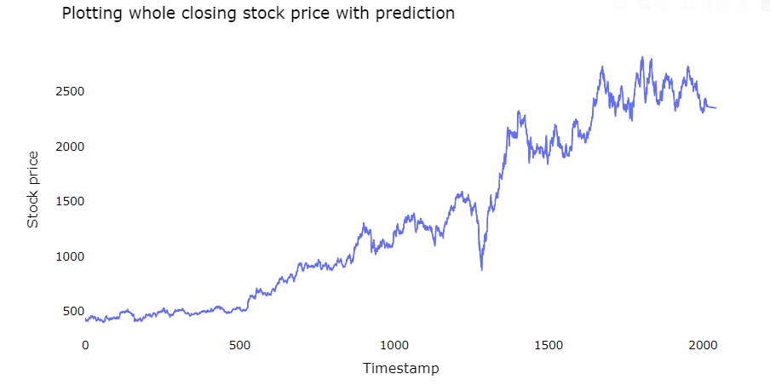
CLOSE PRICE PREDICTION
The graph visualizes historical closing stock prices along with the predicted values, enabling a holistic view of the stock's performance over time
The prediction of the close price shows upward trend for stock prices

Slide 22
SUPPORT VECTOR MACHINE (SVM) CLASSIFFIER
Support Vector Machine
Accuracy – 49.26%
49.26%

Slide 23
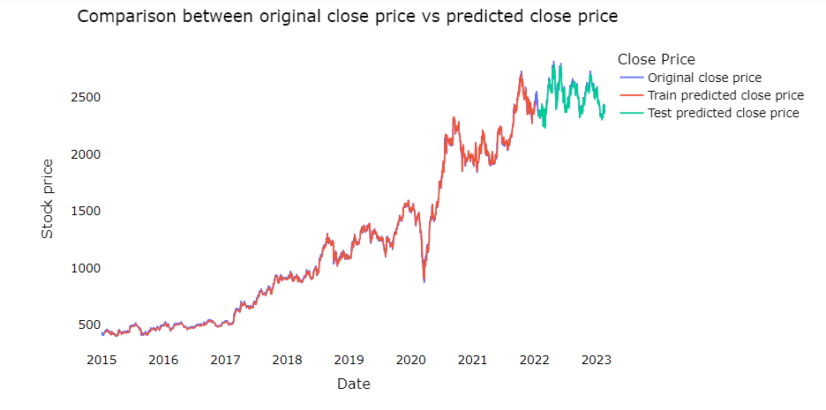
CLOSE AND ORIGINAL PRICE COMPARISON
The graph visualizes the model's predictions for both the training and testing datasets, providing a clear representation of the model's performance across different sets of data
The plotted data enables the analysis of temporal trends in stock prices, offering insights into the historical behavior of the stock and potential patterns over time
The graph shows the preparation of data for visualizing the comparison between original and predicted stock prices

Slide 24
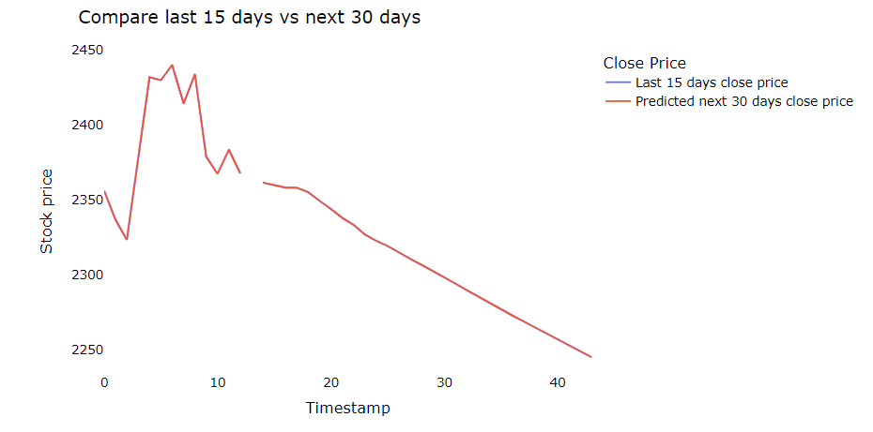
15 AND 30 DAYS CLOSE PRICE COMPARISON
The graph visualizes the comparison between the historical stock prices from the last 15 days and the predicted stock prices for the next 30 days
The predicted 30 days close price shows downward trend for stock prices

Slide 25
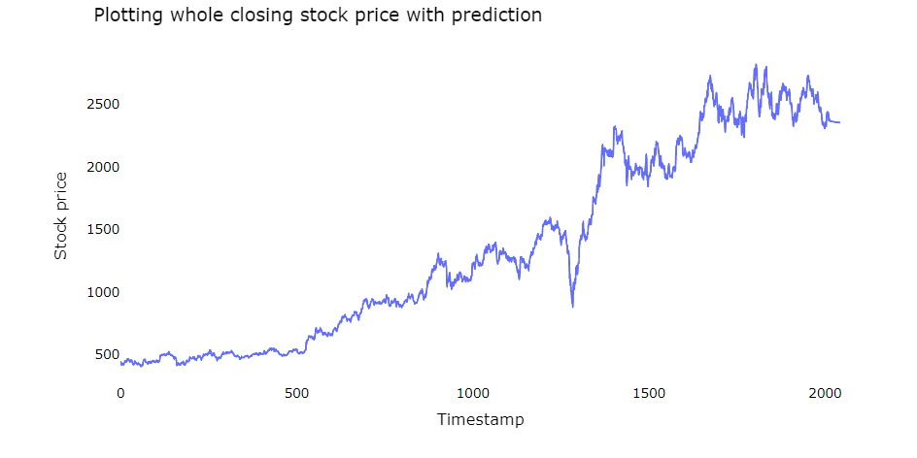
CLOSE PRICE PREDICTION
The graph visualizes historical closing stock prices along with the predicted values, enabling a holistic view of the stock's performance over time
The prediction of the close price shows upward trend for stock prices

Slide 26
RANDOM FOREST
Random Forest
83.94%
Accuracy – 83.94%

Slide 27
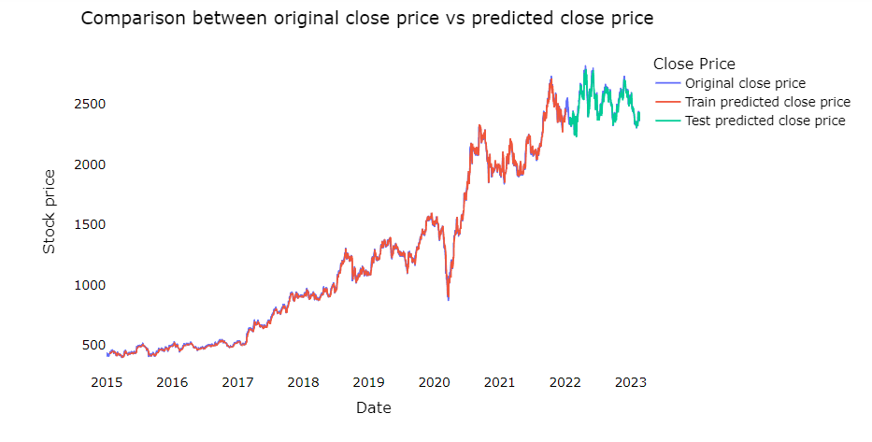
CLOSE AND ORIGINAL PRICE COMPARISON
The graph visualizes the model's predictions for both the training and testing datasets, providing a clear representation of the model's performance across different sets of data
The plotted data enables the analysis of temporal trends in stock prices, offering insights into the historical behavior of the stock and potential patterns over time
The graph shows the preparation of data for visualizing the comparison between original and predicted stock prices

Slide 28
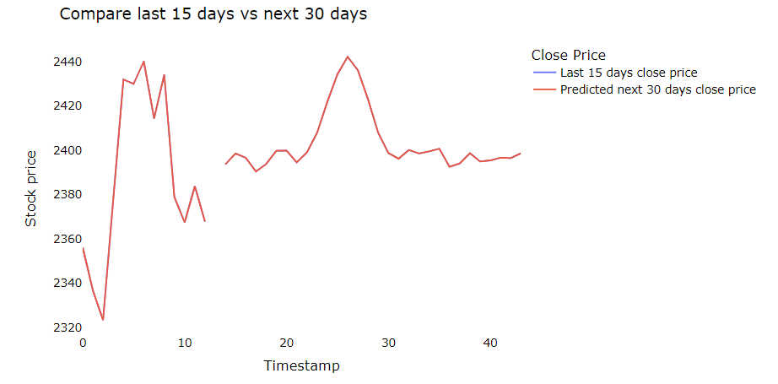
15 AND 30 DAYS CLOSE PRICE COMPARISON
The graph visualizes the comparison between the historical stock prices from the last 15 days and the predicted stock prices for the next 30 days
The predicted 30 days close price shows up and down trend for stock prices.
During timestamp of 20 to 30 it suddenly predicted higher price

Slide 29
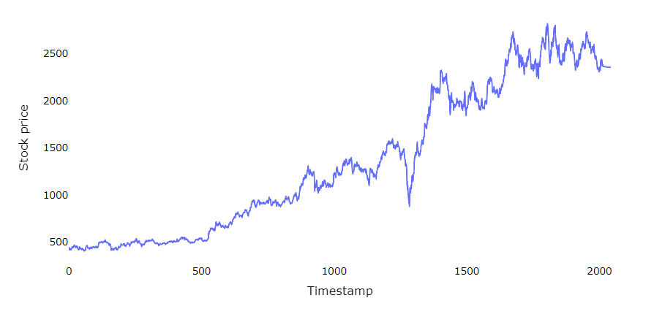
CLOSE PRICE PREDICTION
The graph visualizes historical closing stock prices along with the predicted values, enabling a holistic view of the stock's performance over time
The prediction of the close price shows upward trend for stock prices

Slide 30
GATED RECURRENT UNIT
GRU
Accuracy – 87.53%
87.53%

Slide 31
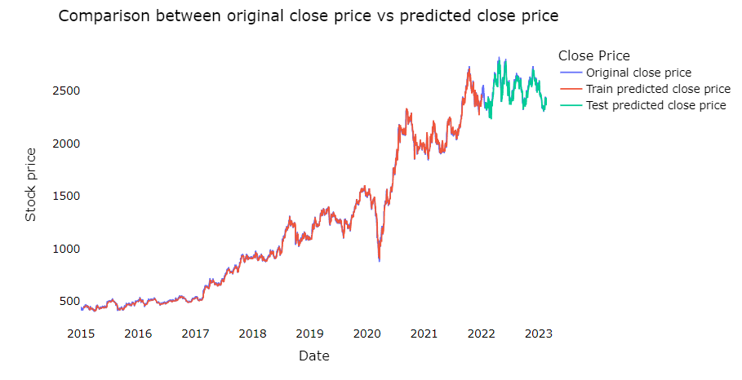
CLOSE AND ORIGINAL PRICE COMPARISON
The graph visualizes the model's predictions for both the training and testing datasets, providing a clear representation of the model's performance across different sets of data
The plotted data enables the analysis of temporal trends in stock prices, offering insights into the historical behavior of the stock and potential patterns over time
The graph shows the preparation of data for visualizing the comparison between original and predicted stock prices

Slide 32
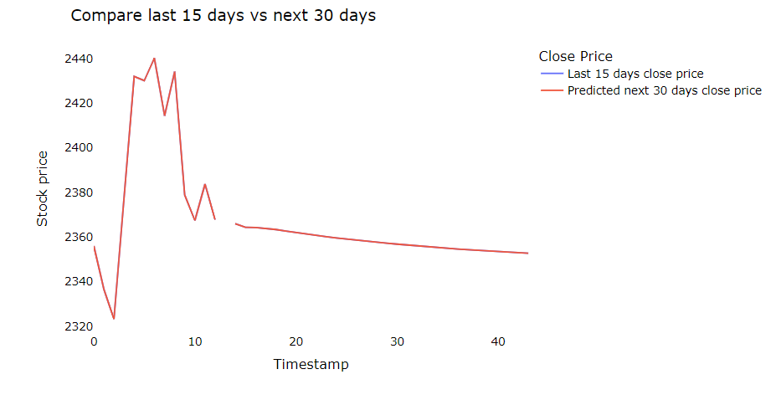
15 AND 30 DAYS CLOSE PRICE COMPARISON
The graph visualizes the comparison between the historical stock prices from the last 15 days and the predicted stock prices for the next 30 days
The predicted 30 days close price shows down trend for stock prices.

Slide 33
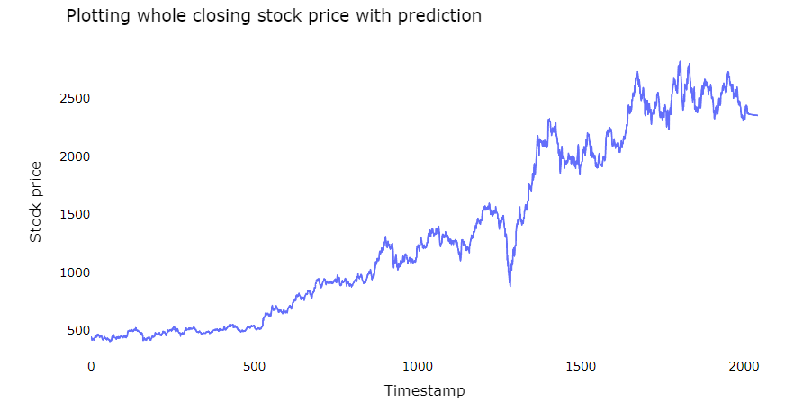
CLOSE PRICE PREDICTION
The graph visualizes historical closing stock prices along with the predicted values, enabling a holistic view of the stock's performance over time
The prediction of the close price shows upward trend for stock prices

Slide 34
LSTM
LSTM
88.67%
Accuracy – 88.67%

Slide 35
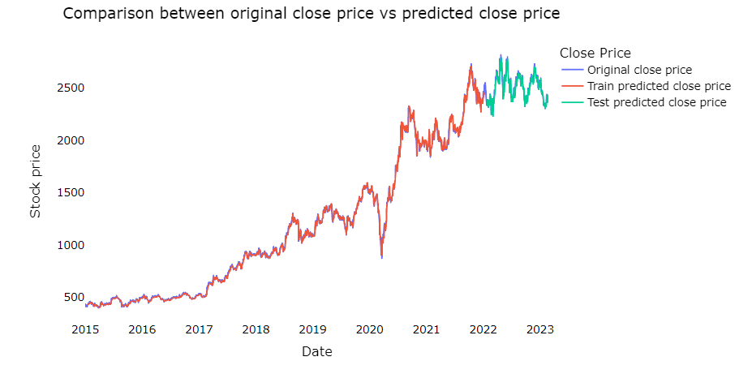
CLOSE AND ORIGINAL PRICE COMPARISON
The graph visualizes the model's predictions for both the training and testing datasets, providing a clear representation of the model's performance across different sets of data
The plotted data enables the analysis of temporal trends in stock prices, offering insights into the historical behavior of the stock and potential patterns over time
The graph shows the preparation of data for visualizing the comparison between original and predicted stock prices

Slide 36
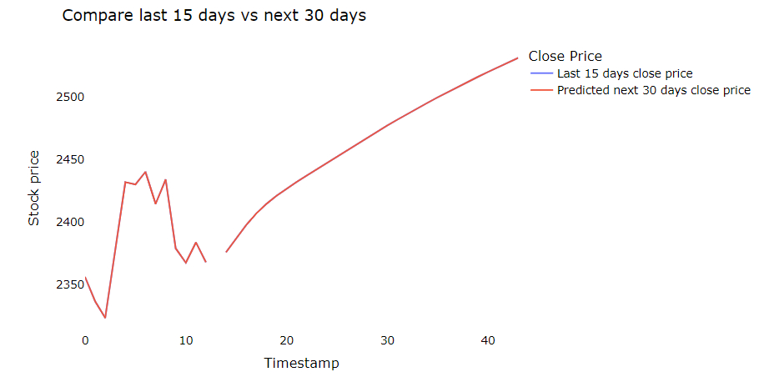
15 AND 30 DAYS CLOSE PRICE COMPARISON
The graph visualizes the comparison between the historical stock prices from the last 15 days and the predicted stock prices for the next 30 days
The predicted 30 days close price shows upward trend for stock prices.

Slide 37
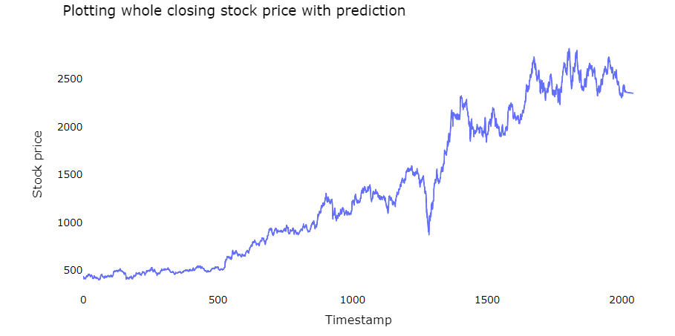
CLOSE PRICE PREDICTION
The graph visualizes historical closing stock prices along with the predicted values, enabling a holistic view of the stock's performance over time
The prediction of the close price shows upward trend for stock prices

Slide 38
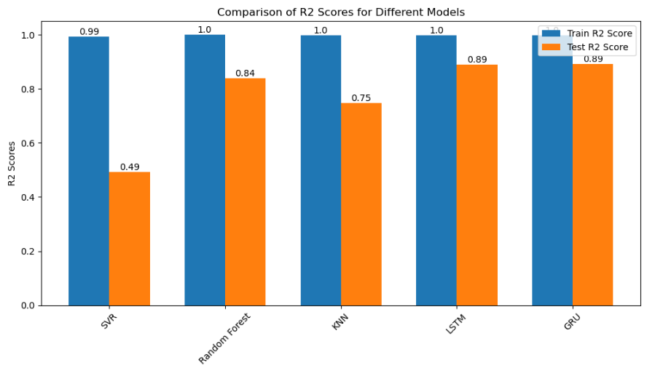
COMPARISON OF R2 SCORES
This bar plot shows accuracy of all models in one frame
As we can see in the graph LSTM gives the highest accuracy
Hence, LSTM will be our finalized model to move further with our Model evaluation / deployment

Slide 39
MODEL DEPLOYMENT
Stock Price Prediction

Slide 40
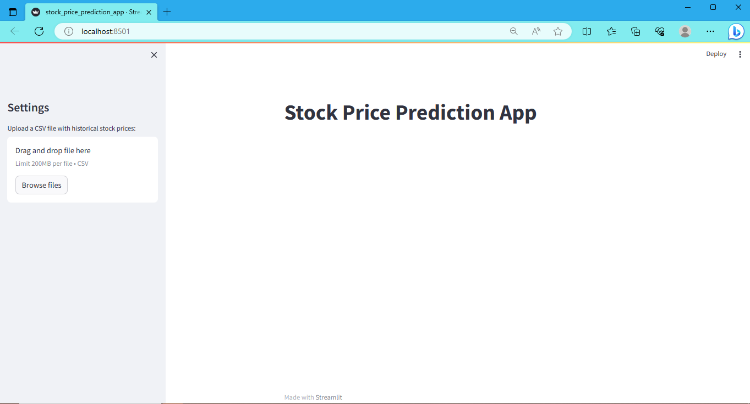
WEBPAGE
This is how the page of our deployment webpage looks like
we have an option to upload dataset to help predict stock prices

Slide 41
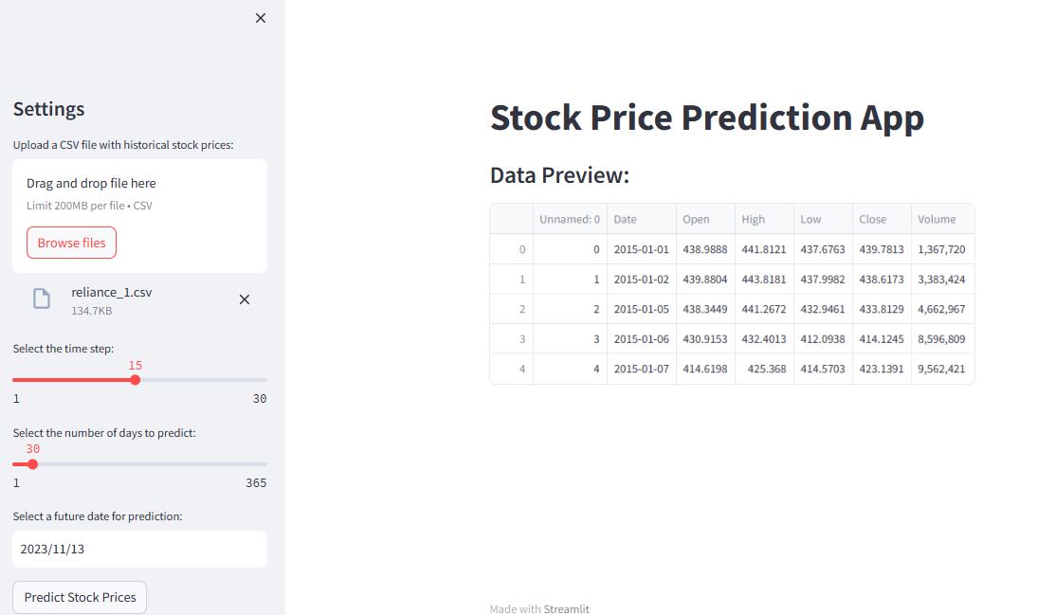
FINAL WEBPAGE TO PREDICT NEWS
Once the dataset is uploaded the webpage will give you an option to select timestamp, number of days to predict and to select date
Once you select all the details click on Predict Stock prices button

Slide 42
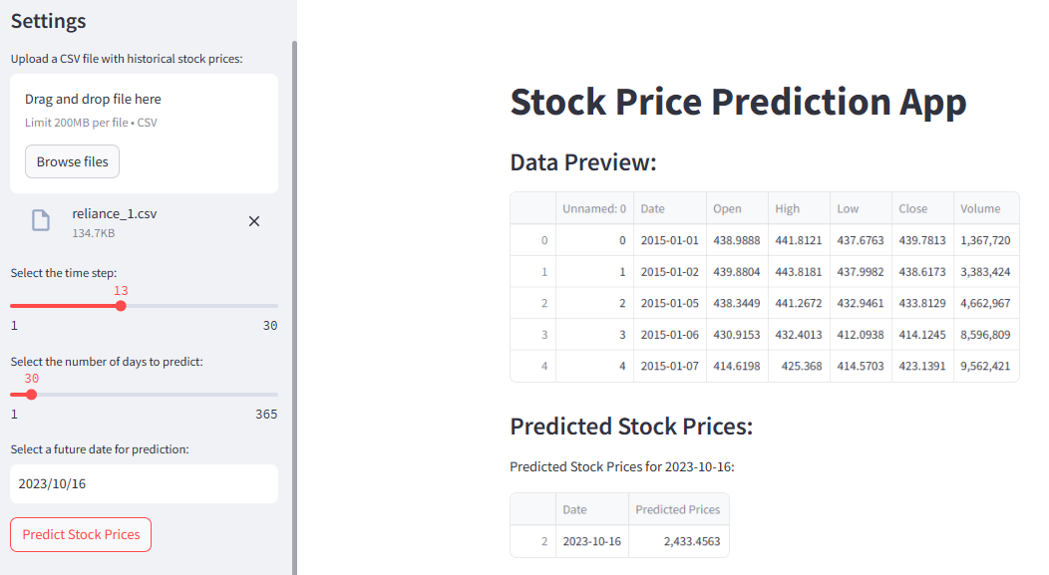
FINAL WEBPAGE TO PREDICT NEWS
After selecting all the necessary options and clicking on Predict button it will show you the predicted stock prices
You can see predicted stock prices and the right hand side under ‘Predicted Stock Prices’ section

Slide 43
OUR TEAM
Mayur D
Soham
Vasim
Apoorva

Slide 44
THANK YOU

